Slide 1

Exploratory Data Analysis and Prediction on Heart Attack
AMS6001 Group Project (Group 2)
FUNG Kam Man / 馮錦文
LIU Tong / 劉通
TIAN Donghao / 田冬皓
XIAO Xin / 肖鑫
HE Xiaoxiao / 何瀟瀟
Nov 27, 2023

Slide 2
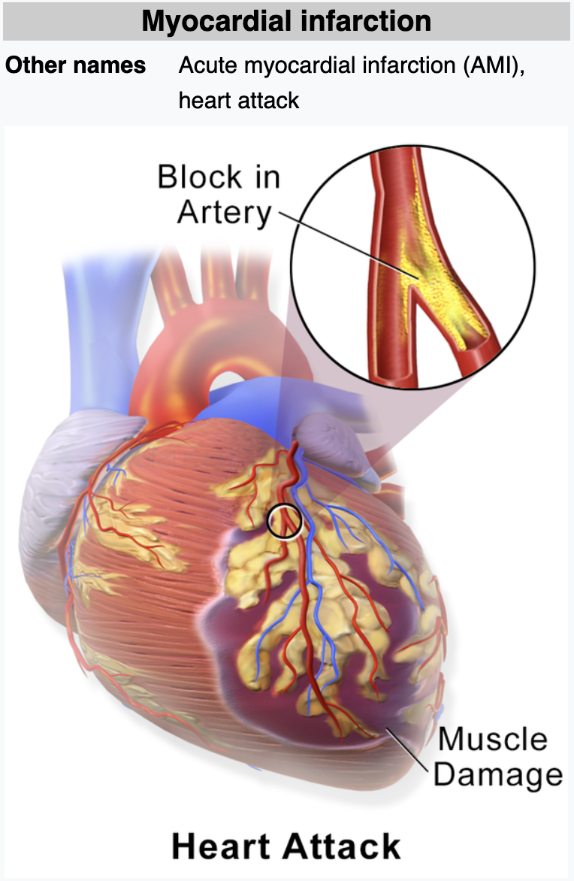

Introduction
Heart Attack -- Definition from the Wikipedia
Goal of Study:
- To explore the dataset through data analysis to identify attributes strongly associated with heart attacks
- To develop a predictive model using data mining techniques to accurately forecast the occurrence of heart attacks
https://en.wikipedia.org/wiki/Myocardial_infarction

Slide 3
Data Preprocessing
Heart.csv : 302 distinct objects, 14 attributes
Numerical Data (5):
age [int.] : Age of the patient
trtbps [cont.] : resting blood pressure (in mmHg)
chol [cont.] : cholestoral in mg/dl fetched via BMI sensor
thalachh [int.] : maximum heart rate achieved
oldpeak [cont.] : ST depression induced by exercise relative to rest
Categorical Data (9):
sex [cat.] : Sex of the patient (1 = male; 0 = female)
exng [cat.] : exercise induced angina (1 = yes; 0 = no)
ca [cat.]: number of major vessels (0-3)
cp [cat.] : Chest Pain type
fbs [cat.] : fasting blood sugar (> 120 mg/dl) (1 = true; 0 = false)
restecg [cat.] : resting electrocardiographic results
slp [cat.] : The slope of the peak exercise ST segment
thall [cat.] : Thal rate
output [cat.] : target (0= less chance of heart attack; 1= more chance of heart attack)
Source: https://www.kaggle.com/datasets/rashikrahmanpritom/heart-attack-analysis-prediction-dataset/data

Slide 4
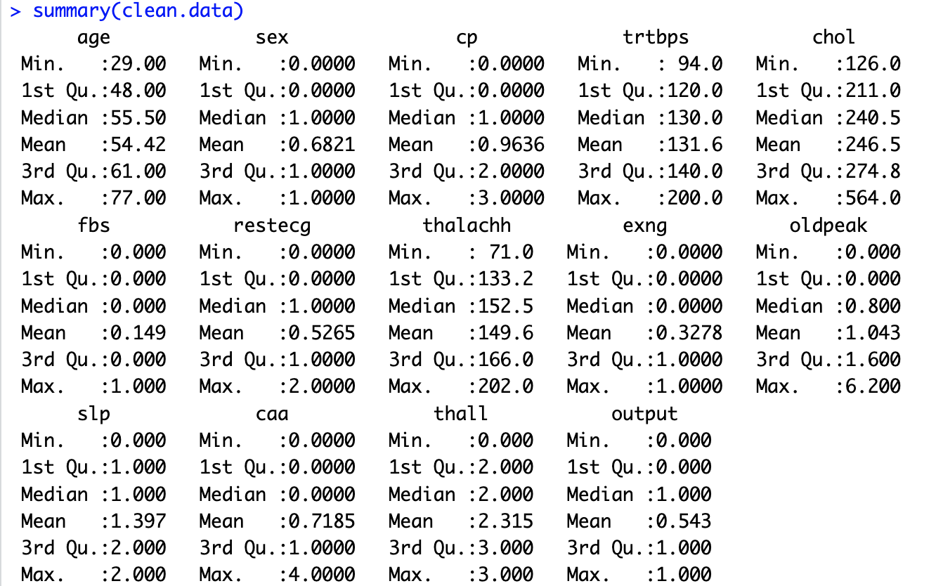
Exploratory Data Analysis (1) Summary Statistics

Slide 5
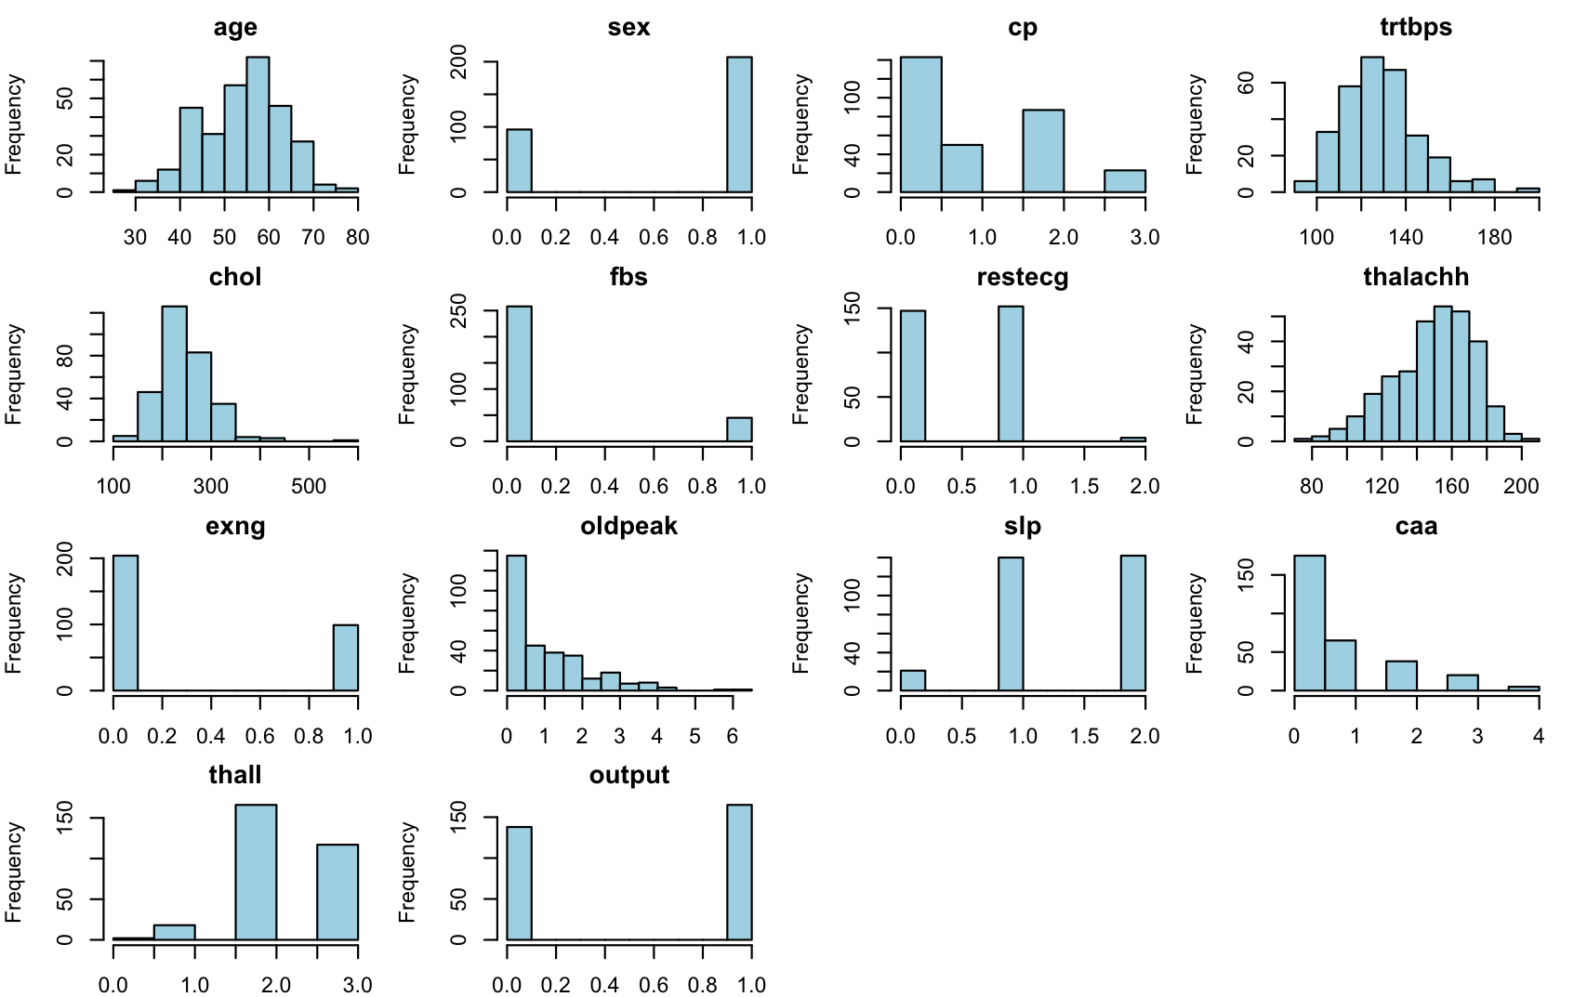
Exploratory Data Analysis (2) Summary Statistics

Slide 6
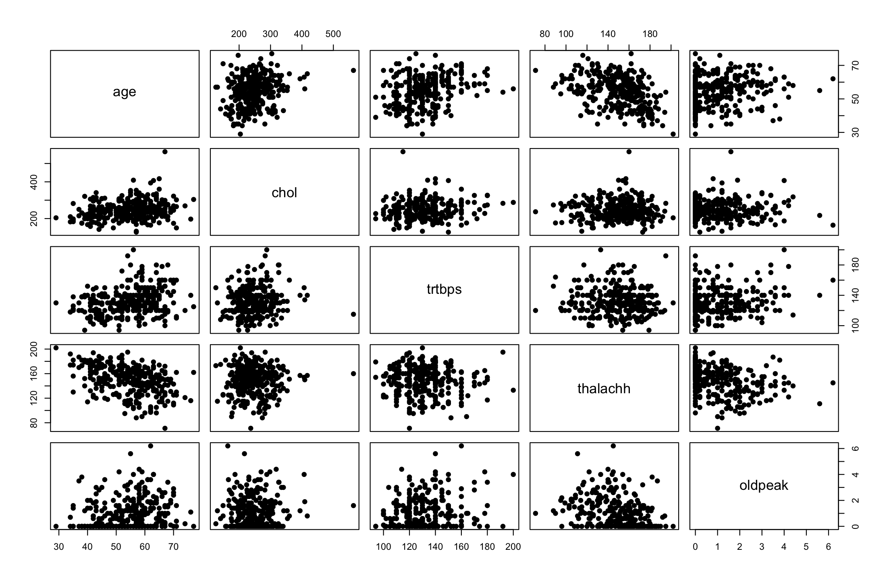
Exploratory Data Analysis (3) Summary Statistics
Notes:
There are no strong correlation between numerical attributes

Slide 7
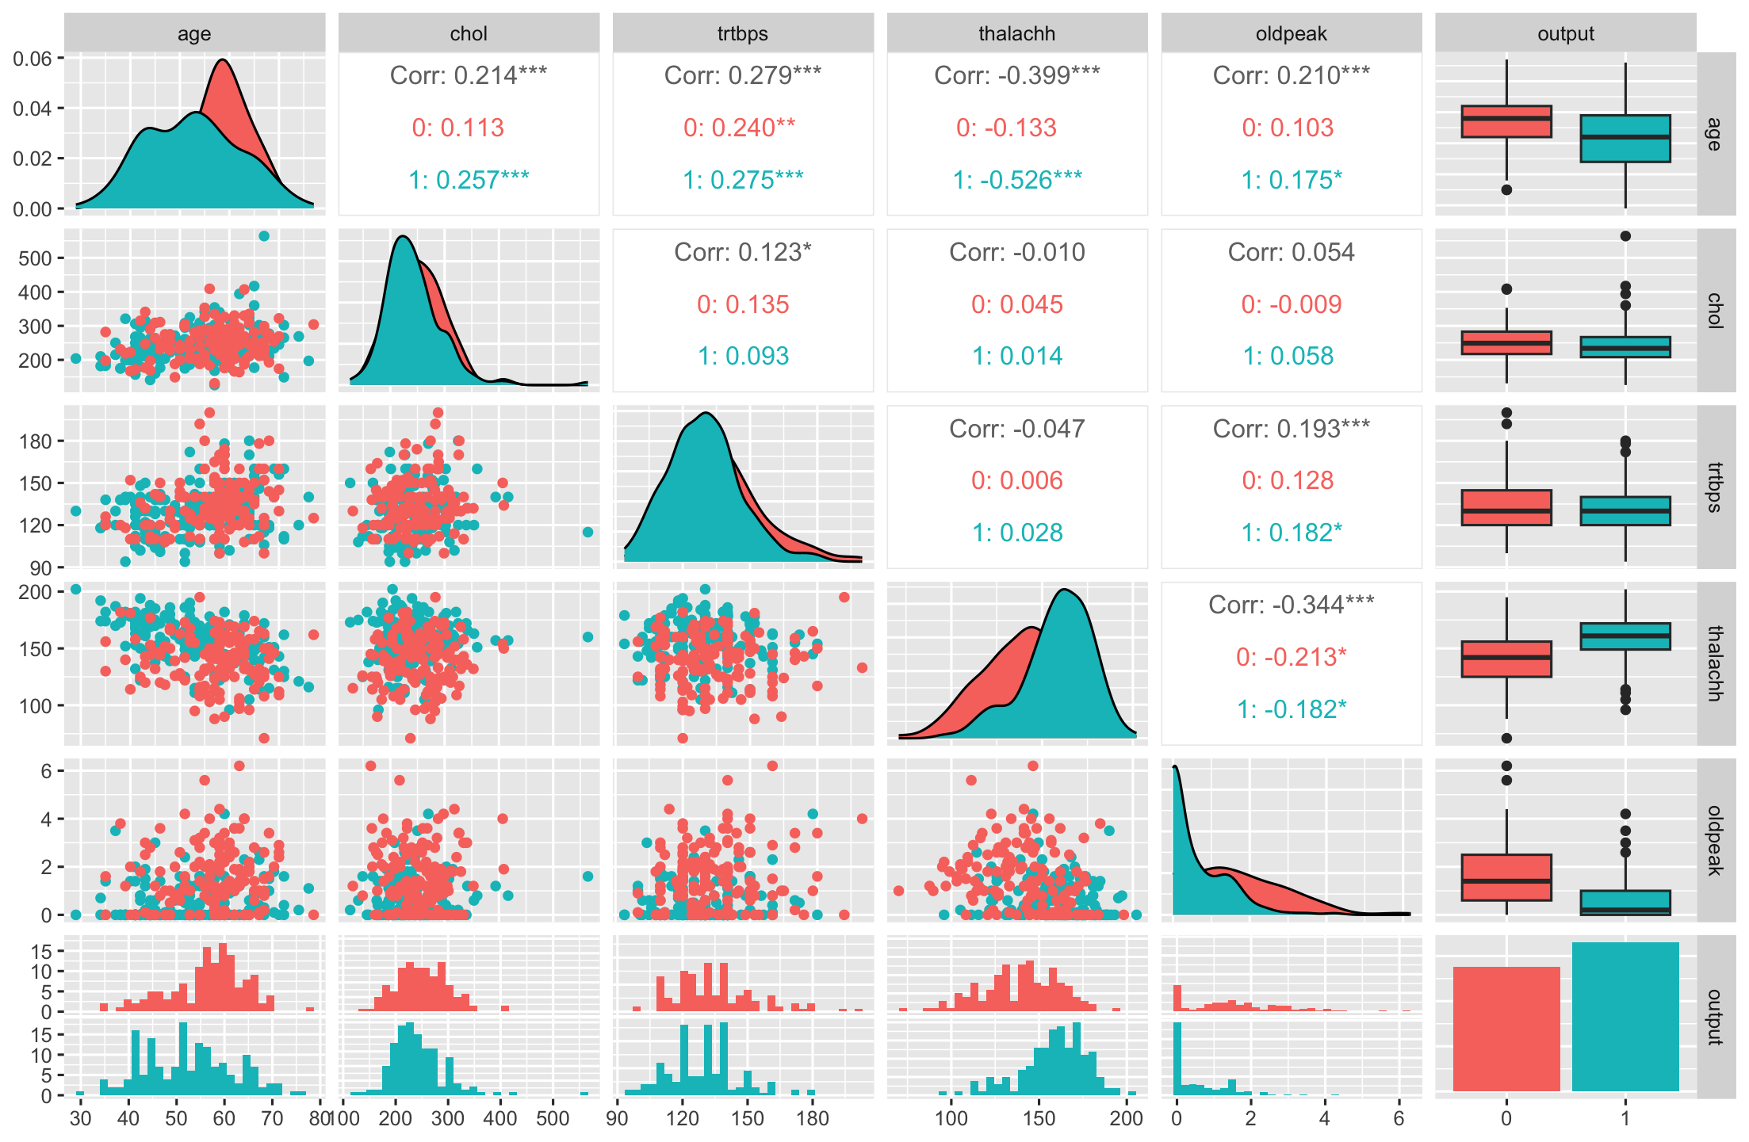
Exploratory Data Analysis (4) Summary Statistics
Notes:
There are no strong correlation between numerical attributes nor with the output.

Slide 8
Modeling Techniques (1) Algorithms
Notes:
Choose a Suitable Algorithm: Select an appropriate data mining algorithm based on the problem at hand, the characteristics of the dataset, and your goals. Some algorithms that can handle mixed attribute types include decision trees, random forests, Naive Bayes classifiers, and ensemble methods like Gradient Boosting and AdaBoost.
Train the Model: Split the dataset into training and testing sets. Use the training set to train the chosen model on the data.
Evaluate the Model: Use the testing set to evaluate the performance of the trained model. Calculate appropriate evaluation metrics such as accuracy, precision, recall, F1-score, or area under the ROC curve (AUC-ROC) based on the problem type.

Slide 9
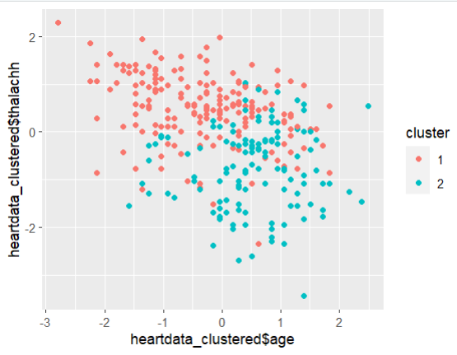
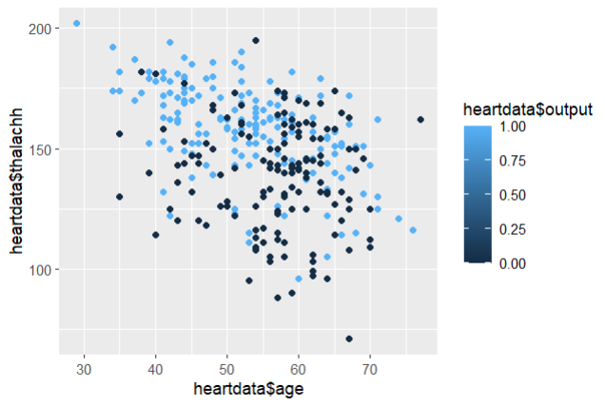
K-means clustering
Modeling Techniques (2) Model Training
#Exploring data with 0,1 values as they won't be of much help in making the clusters
heartdata_c = heartdata[,-which(colnames(heartdata) %in% c("sex","fbs","exng","output"))]
# Standardize the dataset and apply K-means clustering
heartdata_scale = scale(heartdata_c)
km <- kmeans(heartdata_scale, centers = 2, nstart = 10)
heartdata_clustered <- as_tibble(heartdata_scale) %>% add_column(cluster = factor(km$cluster))
ggplot(heartdata_clustered,aes(x=heartdata_clustered$age,y = heartdata_clustered$thalachh, color = cluster)) + geom_point()
#actual output
ggplot(heartdata, aes(x = heartdata$age, y = heartdata$thalachh, color = heartdata$output)) + geom_point()
Accuracy = 0.78
Notes:
Train the Model: Split the dataset into training and testing sets. Use the training set to train the chosen model on the data.

Slide 10
Modeling Techniques (3) Model Evaluation
Notes:
Train each candidate model on the training set using appropriate hyperparameters and model configurations.
Evaluate the performance of each model on the testing set using the selected evaluation metrics. This helps you assess how well each model generalizes to unseen data.
Choose appropriate evaluation metrics based on the nature of the problem.
For classification tasks, common metrics include accuracy, precision, recall, F1-score, and area under the ROC curve (AUC-ROC).
For regression tasks, metrics such as mean squared error (MSE), mean absolute error (MAE), and R-squared can be used.

Slide 11
Model Comparison
Notes:
Compare the performance of different models based on the evaluation metrics. Consider both the overall performance and the specific requirements of your problem. For example, if interpretability is important, you may prefer a simpler model even if its performance is slightly lower.
Based on the performance comparison, select one or a few models that exhibit better performance on the evaluation metrics and align with your goals and requirements. These models are considered promising candidates.

Slide 12
Model Validation
Notes:
Take the selected promising models and validate them using a separate validation dataset or cross-validation. This step helps to assess the final model's generalization performance and ensure that it performs well on unseen data.

Slide 13
Final Model Selection
Notes:
Based on the validation results, select the final model that performs well on the validation dataset or demonstrates consistent performance across cross-validation folds. Consider factors such as overall performance, interpretability, complexity, and any other relevant considerations.

Slide 14
Conclusion

Slide 15
References
Detrano, Robert C. et al. “International application of a new probability algorithm for the diagnosis of coronary artery disease.” The American journal of cardiology 64 5 (1989): 304-10
https://arxiv.org/pdf/2007.02854.pdf
Notes:
1. https://www.ajconline.org/article/0002-9149(89)90524-9/pdf
Abstract
A new discriminant function model for estimating probabilities of angiographic coronary disease was tested for reliability and clinical utility in 3 patient test groups. This model, derived from the clinical and noninvasive test results of 303 patients under-going angiography at the Cleveland Clink in Cleveland, Ohio, was applied to a group of 425 patients undergoing angiography at the Hungarian Institute of Cardiology in Budapest, Hungary (disease prevalence 38%); 200 patients undergoing angiography at the Veterans Administration Medical Center in Long Beach, California (disease prevalence 75%); and 143 such patients from the University Hospitals in Zurich and Basel, Switzerland (disease prevalence 84%). The probabilities that resulted from the application of the Cleveland algorithm were compared with those derived by applying a Bayesian algorithm derived from published medical studies called CADENZA to the same 3 patient test groups. Both algorithms overpredicted the probability of disease at the Hungarian and American centers. Overprediction was more pronounced with the use of CADENZA (average overestimation 16 vs 10% and 11 vs 5%, p < 0.001). In the Swiss group, the discriminant function underestimated (by 7%) and CADENZA slightly overestimated (by 2%) disease probability. Clinical utility, assessed as the percentage of patients correctly classified, was modestly superior for the new discriminant function as compared with CADENZA in the Hungarian group and similar in the American and Swiss groups. It was concluded that coronary disease probabilities derived from discriminant functions are reliable and clinically useful when applied to patients with chest pain syndromes and intermediate disease prevalence.

Slide 16
Thank you
Q & A

Slide 17
Appendix I: Dataset description
Heart.csv : 303 objects, 14 attributes
age [int.] : Age of the patient
sex [cat.] : Sex of the patient (1 = male; 0 = female)
exng [cat.] : exercise induced angina (1 = yes; 0 = no)
caa [cat.]: number of major vessels (0-3)
cp [cat.] : Chest Pain type
1 - typical angina
2 - atypical angina
3 - non-anginal pain
4 - asymptomatic
trtbps [cont.] : resting blood pressure (in mmHg)
chol [cont.] : cholestoral in mg/dl fetched via BMI sensor
fbs [cat.] : fasting blood sugar (> 120 mg/dl) (1 = true; 0 = false)
restecg [cat.] : resting electrocardiographic results
0 - normal
1 - having ST-T wave abnormality (T wave inversions and/or ST elevation or depression of > 0.05 mV)
2 - showing probable or definite left ventricular hypertrophy by Estes' criteria
thalachh [int.] : maximum heart rate achieved
slp [cat.] : The slope of the peak exercise ST segment (1 = upsloping; 2 = flat; 3 = downsloping)
oldpeak [cont.] : ST depression induced by exercise relative to rest
thall [cat.] : Thal rate
output [cat.] : target (0= less chance of heart attack; 1= more chance of heart attack)
Source: https://www.kaggle.com/datasets/rashikrahmanpritom/heart-attack-analysis-prediction-dataset/data

Slide 18
Appendix II: R Packages & Codes

